Slide 1


Sacramento King-Makers
NBA Player Classification: Leveraging Analytics to Redefine Player Roles in the Modern NBA

Slide 2
CONTENTS
01
02
03
04
05
06
07
Historical & Current Cluster Analysis
Final Recommendations
Executive Summary
Player Clustering
Application
Recommendations
Future Work

Slide 3
Your Team
Anaswar Jayakumar
Machine Learning/Analytics
Arthur Swanson
Data Engineering
Danish Moti
Strategy
John Kramarczyk
Product
Michael Kaminski
Machine Learning/Strategy

Slide 4
Executive Summary - Anaswar, Arthur, Danish, John

Slide 5
Overview - Anaswar
Inception - 1970s League was dominated by big men
1980s - modern era
Three point shot introduced, less reliance on big men
Sacramento Kings hold longest playoff drought in NBA
To break this streak, Kings management must find good players who can work together and win games while staying within cap space
Leverage data science techniques to find value in players other franchises would otherwise leave behind
1990s - 2000s Shift to defensive minded strategy
2010 - Present
Three point revolution, higher scoring games, faster pace.

Slide 6
Objective/Problem Statement - Arthur
Sacramento Kings management realize
Immediate desire to end the playoff drought
Modern NBA is now in a “position-less” era
Immediate need to construct a roster reflective of modern NBA to be successful
The needs that lay the foundation for the proposed objectives
End playoff drought
Making playoffs is of utmost importance to fans
Building competitive roster is of foremost importance
“POSITION-LESS” ERA
Teams have already started to adapt to a “POSITION-LESS” ERA OF BASKETBALL that is representative of the modern NBA have seen great success in the postseason
PROPOSED OBJECTIVES
Adapt to a new “position-less” era of NBA basketball
Build a competitive roster that can compete in the modern NBA
End a 16-year playoff drought

Slide 7
Approaches - Danish
Dashboard & Application
Created dashboard and application that management can leverage when building out the optimal roster, providing quick analyses and visualizations of key points.
4
Deep EDA for Predictions
Conducted deep EDA to better understand understand the core dataset for our models and regression models that predict regular season wins.
Deliverable
3
2
Mock Draft Developed
Performed mock draft based on player types and what the team needs each year. This is critical to long-term success.
Redefined NBA Player Types
Built an optimal roster by redefining traditional player positions - created new player types that are reflective of the modern NBA.
1

Slide 8
Completed Deliverables - John
Deliverable 1
Deliverable 2
Deliverable 3
Deliverable 4
Traditional Player Positions Redefined
Mock Draft Developed
Win Model Prediction
Dashboard &
Application
New player types were determined
New potential rosters were identified
An interactive and engaging mock draft created for the 2022-2023 season
Mock draft leverages agent-based simulation
EDA to identify key factors to get more wins
Multiple models fitted to predict wins on team data with different optimization metrics
Dashboard includes lineup optimizer tool - exploits other team’s weaknesses
Application provides analysts and management inside detailed look into data
Notes:
EDA on team statistics to understand the dataset,
Dashboard includes lineup optimizer tool that exploits other team’s weaknesses based on redefined player types
Application provides Sacramento King’s Analysts, management inside detailed look into data used

Slide 9
Player Clustering - Michael

Slide 10
New Player Types
01
02
03
04
05
06
07
Game
Generals
MVP
Bigs
Well-Rounded Bigs
Physical
Bigs
Three-point Threats
Game Lieutenants
Shot-Creating Sharpshooters
Notes:
After running our k-means clustering analysis, we arrived at 7 new player types - say all of their names. These naming conventions were assigned based the underlying characteristics or statistics of each player within the cluster - do they get rebounds? Do they manage the game? Are they good shooters? How do they make contributions during a game?

Slide 11
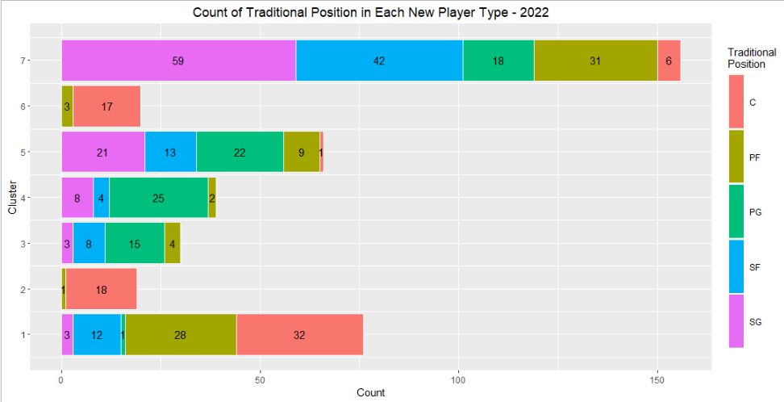
Traditional Player Position Vs New Player Types
Notes:
The plot below shows the count of each new player type based on each player’s traditional position in the 2021-22 season. Each new player type includes at least two players from a traditional position and three of the new player types even include players from all 5 of the traditional positions.

Slide 12
Background on Stats used for analysis
Per 100 Possessions &
Per Game
Rebounds (Off, Def, Total)
Assists
Steals
Points
Turnovers
Blocks
FGs
FTs
3pFGs
Shooting
0-3ft, 3-10ft, 10-16ft, 16ft- 3p
FG% per distance
FGM and FGA per distance
Do they shoot close or far?
What percentage of there shots come from each region?
Advanced
Offensive Rating
Defensive Rating
Player Efficiency Rating (PER)
Usage
Win Shares
Box Score
+/- (Off, Def, Total)
Value Over Replacement (VORP)
Notes:
Overall, we used 73 different features or statistics the 2000-01 season to the 2021-22 season. These were scraped from basketball-reference.com.
Per 100 Possessions and per game
These are your typical statistics: rebounds, assists, steals, points, turnover, blocks, Field goal, free throw, and three point attempts, makes, and shooting percetange.
Per 100 possession helps account for pace of play and puts teams/players on an equal footing - For example if a team averages 75 possessions per game, then they’re likely to score more points and get scored on more than a team averaging 60 possessions per game.
Per game helps add a bit of color to how players perform each game, regardless of their pace of play
Shooting:
These stats measure the attempts, makes, and shooting percentages from different area of the floor: 0-3 ft, 3-10, 10-16, 16 to the 3point line. This helps us determine if players shoot close or far from the hoop and how frequently they shoot form each area.
Advanced:
These stats are non-traditional stats and generally are combinations of other traditional stats
Player efficiency rating, or PER, sums up all a player's positive accomplishments, subtracts the negative accomplishments, and returns a per-minute rating of a player's performance
A linear formula is used and various weights are applied to field goals made and missed, steals, 3-pointers made, free throws made and missed, blocks, off and def rebounds, asts, fouls and turnovers

Slide 13
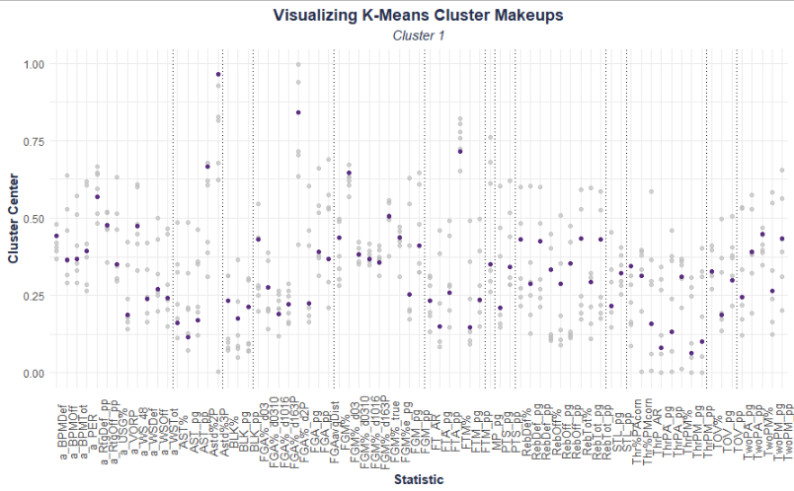
Cluster 1 - Well Rounded Bigs
Only rank first, second in few stats, don’t rank last in any of them
Ranked fourth in 30 stats - average between player types.
76 players in 2022
Examples include:
Al Horford
Demarcus Cousins
Dwight Howard
Rank third in defensive BPM, offensive rating, blocks, offensive rebounds, total rebounds
Rank second in FG%, have second worst FT%. Rank sixth in assists
Notes:
The graph on the left displays each feature or NBA stat used in the kmeans clustering model. The darker points indicate the current cluster - or Player Type - while the light dots represent the other clusters. The dark point’s position on the graph in each column represents where that player type ranks among the other player types.. If we look at the first column (which measures the defensive box score +/-) Well-Rounded Bigs rank third (first and second overlap) among the player types, indicating that their in-game contributions for defensive box score +/- have a higher impact than all but two of the other clusters. If we look at the second column, Offensive box score +/-, they rank 4th, which is average among the player types. The dotted vertical lines partition the data so that similar stats are grouped together (advanced, assists, blks, field goals, free throws, points, etc.)
Well-Rounded Bigs make up 76 of 406 players who played in the 2022 season. They rank first or second in only a few stats, however they don’t rank last in any of them. They rank fourth, or average, in 30 of the 73 stats. Their contributions align most with the traditional center position.

Slide 14
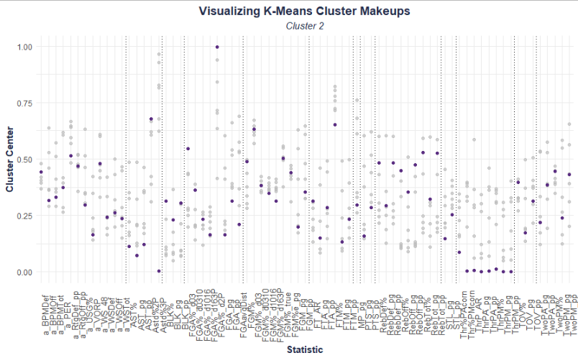
Cluster 2 - Physical Bigs
Specific types of a traditional center
Physical, strong, hang out close to the rim
19 players in 2022
Examples include:
Andre Drummond Clint Capela
DeAndre Jordan
Don’t get a ton of playing time or points
Physical presence is felt on both ends of the floor
Notes:
Well-Rounded Bigs make up only 19 of 406 players who played in the 2022 season. Like Well-Rounded Bigs, their contributions align most with the traditional center position, however they rank towards the bottom in most stats, specifically minutes and points. When they do play, they play physical and close to the rim on both ends of the floor.

Slide 15
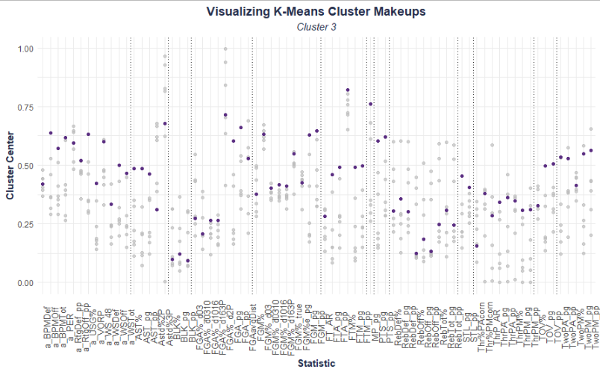
Cluster 3 - Game Generals
Ranked first in 31 stats
Ranked second in 9 - ranked below average in 7 stats
30 players in 2022
Examples include:
LeBron James James Harden Stephen Curry
Control the speed and pace of the game
Generally includes the teams’ main ball handler
Notes:
These players are you’re superstars - Lebron, James Harden, Steph Curry - they make up 30 of the 406 players. They rank first in 31 stats, second in 9 stats, and only fall below average in 7 stats. These players do it all, generally leading in the advanced statistics. They control the speed and pace of game and generally are their team’s main ball handler.

Slide 16
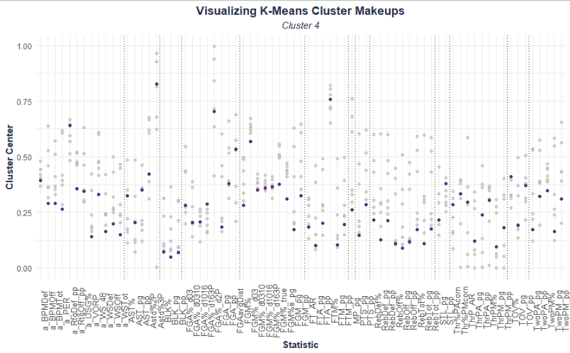
Cluster 4 - Game Lieutenants
Generally come in off the bench
Only ranked in the top 3 for 10 stats
39 Players in 2022
Examples include:
Lou Williams Markieff Morris Rajon Rondo
Provides supporting role on the offensive end as ball handlers
Ranked second to last in 14 stats, rank last in 30 stats
Notes:
These players come in off the bench and provide a supporting role to the Game Generals - serving as the back-up ball handlers. They make up 39 of the 406 players in the league. They only rank in the top 3 for 10 different stats and they rank second to last or last in 44 stats.

Slide 17

Cluster 5 - Shot Creating Sharpshooters
Not ranked first in any stats
They’re still important to the team
66 players in 2022
Examples include:
D’Angelo Russell Derrick Rose
Klay Thompson
Ranked third in a lot of categories
Love shooting threes, getting assists
Notes:
This player type includes 66 players currently in the league. While they don’t rank first in any of the stats, they’re still a crucial part of any team - ranking third in most stats after Game Generals and MVP Bigs. They shoot a lot of threes and get a lot of assists.

Slide 18
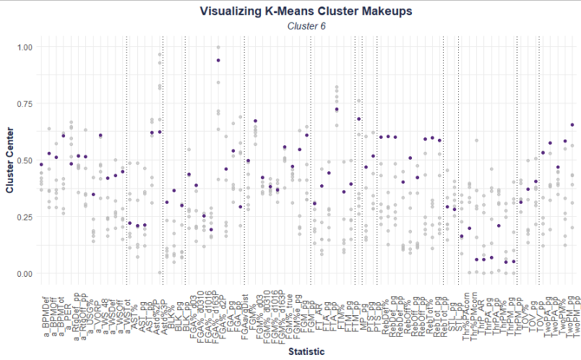
Cluster 6 - MVP Bigs
The players mentioned were Top 3 in the 2022 NBA MVP race
These players EMPHASIZE the importance of this position
20 players in 2022
Examples include:
G. Antetokounmpo Joel Embiid
Nikola Jokic
Rank first in 22 stats
Ranked second in 29 (mostly second only to Floor Generals)
Notes:
These are your big man superstars - there’s only 20 in the league. They rank first in 22 stats and second in 29, likely only being out ranked by Game Generals. The notable players in this player type include Giannis, em-bee-d, and yo-kich, who were the top 3 vote recipients in the 2022 MVP awards. The only other players to receive 2nd or 3rd place votes were Game Generals Devin Booker and Luka Don-chich and it wasn’t even close. The importance of this player type could indicate a shift in the NBA style of play, moving from the 3-point shooting era of the 2010s into a style more focused on MVP caliber big men.

Slide 19
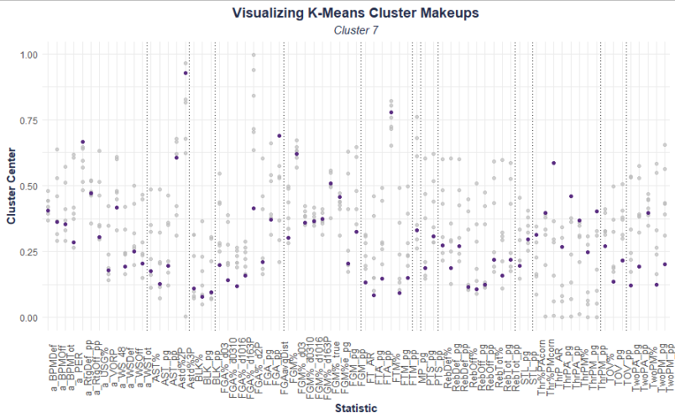
Cluster 7 - Three Point Threats
By far the MOST COMMON
High number makes sense given how the NBA has evolved towards the 3-point shot.
156 players in 2022
Examples include:
Blake Griffin | Carmelo Anthony | Lonzo Ball
Generally rank first or second in 3-point shooting categories
Resembles Shot-Creating and Sharpshooters player types
Notes:
This is the most common player, including nearly 40% of the players in the league. And given the shift of importance and reliance on the three-pointer in recent years, this make sense. These players generally rank first or second in all three point shooting categories, which resembles the playing style of Shot-Creating Sharpshooters.

Slide 20
Historical and Current Cluster Analysis - John

Slide 21
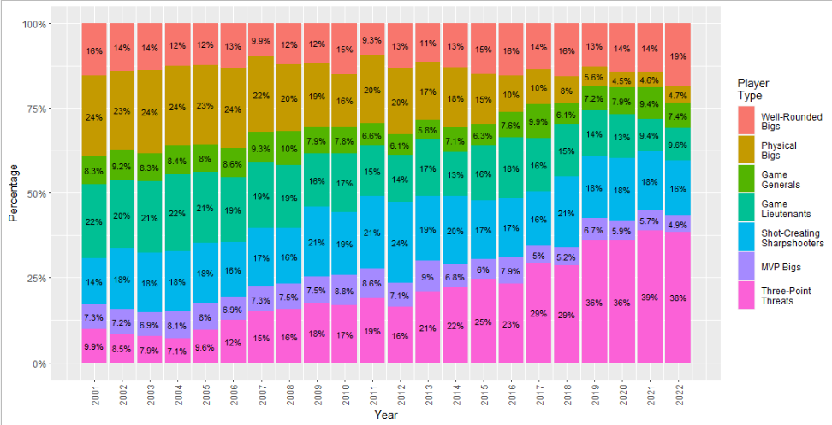
Historical and Current Cluster Analysis
Well-Rounded Bigs
Physical Bigs
Have had their UPS and DOWNS.
Range from 9.3% to 19% of players in the league, however it’s not that different today than it is from 2001.
Have steadily decreased, appears close to BECOMING OBSOLETE.
As the style of play has changed, so has the need for this specific player type.
Game Generals
Have more or less remained consistent
as been valued every season.
Notes:
The graph on the left tells us the percentage of each player type in the league during each season.
Well-rounded bigs have fluctuated over the years, however their 2022 number closely resemble their 2001 numbers.
Physical bigs have steadily declined over the years and have the potential to become obsolete. However, with the importance of MVP Bigs in the current state of the NBA, it’s possible that this player type could increase over the next few seasons,
Game Generals have typically hovered around 6-10% year over year.

Slide 22
Historical and Current Cluster Analysis
Game Lieutenants
Shot-Creating Sharpshooters
Have steadily decreased.
Likely have transitioned into Three-Point Threats over the years.
Have had equal periods of increase and decrease.
MVP Bigs
Three-Point Threats
Have remained relatively constant, but appear to be phasing out.
Grown significantly over the date range.
Clear indication that 3-point shooters are MORE COMMON THAN EVER.
Notes:
Game Lieutenants have seen a steady decrease, likely transitioning into more of a Three-Pointer Threat player type over the years.
Shooting Creating Sharp shooters have generally hovered around 15-20% throughout the years
MVP bigs were the most common between 2010 and 2016, before slowly fading, which could be due to their excellent performance - given that their level of talent is hard to come by
Three-point threats have grown significantly since 2012, especially from 2018 to 2019, which indicates a clear shift in the ways that teams are utilizing the three-point shot

Slide 23
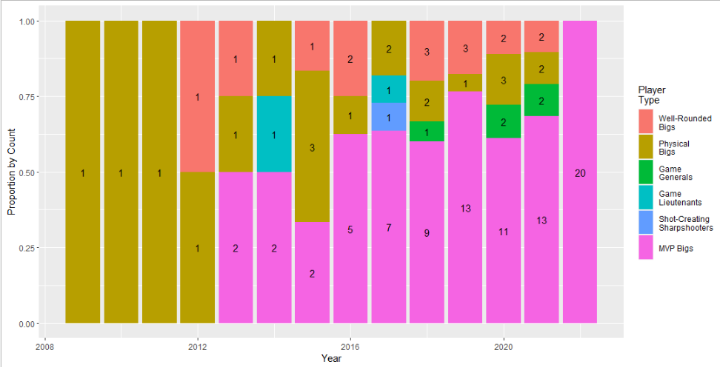
Player Type History of MVP Bigs
The plot on the right shows the current MVP Bigs in the league
The x-axis indicates the year, bars indicate count of historical player types for each current MVP Bigs
Generally speaking, it would appear that Well-Rounded Bigs, Physical Bigs transition into MVP Bigs most often
Indicated by frequency of red and gold
Notes:
In order for us to better analyze our current roster, we looked at the history of the two most important player types: MVP Bigs and Game Generals. Given the rarity of these player types, it might be difficult to acquire them through the NBA draft or even in free agency. We want to know which player types generally develop or evolve into MVP Bigs and Game Generals so that we can see if there’s room for development on our current roster
The pink bar on the far right tells us the current number of MVP Bigs in the league, while the bars preceding it tell us the MVP Bigs’ historical player type. From the graph, we see that a number of Well-Rounded Bigs (red) and Physical Bigs (gold) have evolved into MVP Bigs. Given this, we should look at our current roster and see if we have these player types and work on developing them. If we don’t have these player types,, then we should target in them in the NBA Draft

Slide 24
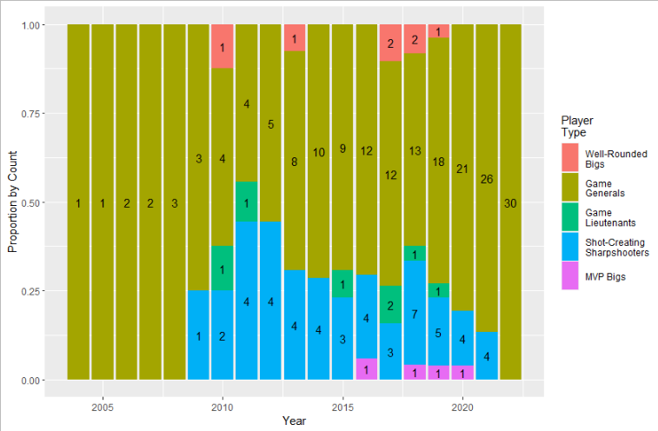
Player Type History of Game Generals
The plot shows the current Game Generals in the league (30, on the right).
x-axis indicates the year, bars indicate the count of historical player types for each current Game Generals
Generally speaking, it would appear that Shot-Creating Sharpshooters player types transition into Game Generals most often
Notes:
The lime colored bar on the far right tells us the current number of Game Generals in the league, while the bars preceding it tell us the Game Generals s’ historical player type. From the graph, we see that a number of shot-creating sharpshooters have evolved into Game Generals . Given this, we should look at our current roster to see if we have this player type and work on developing them. If we don’t have this player type, then we should target in them in the NBA Draft

Slide 25
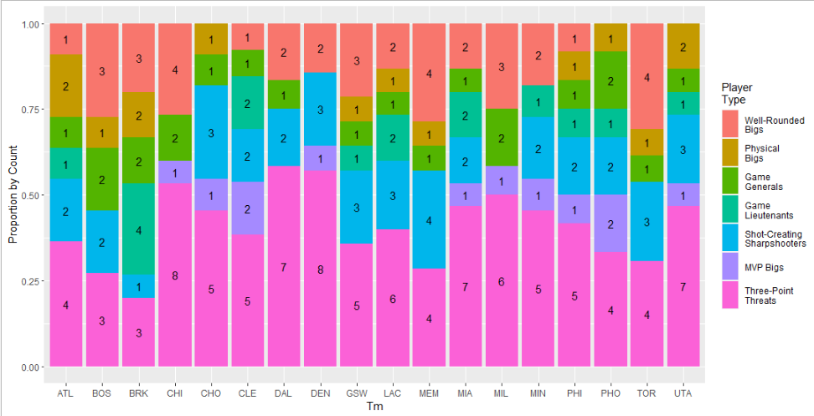
Teams ABOVE .500 in 2022
Cleveland
Has two MVP Bigs and one Game General
Phoenix
Has two Game Generals and two MVP Bigs
Chicago and Milwaukee Have two Game Generals and one MVP Big
Each team
Has at least a Game General or a MVP Big
Boston and Brooklyn
Have two MVP Bigs and no Game Generals
Notes:
In order to see which player types were on successful teams, we analyzed the rosters for teams above .500 and below .500.
What we found with the teams above .500 is that they each had at least one MVP Big or one Game General, with teams like Phoenix having two of both MVP Bigs and Game Generals. In theory, this team should be dominating the league, however they just lost to the Warriors in the Western Conference Finals. Although these players types are important and help teams win games, there’s no guarantee that they’ll win the NBA Championship.

Slide 26
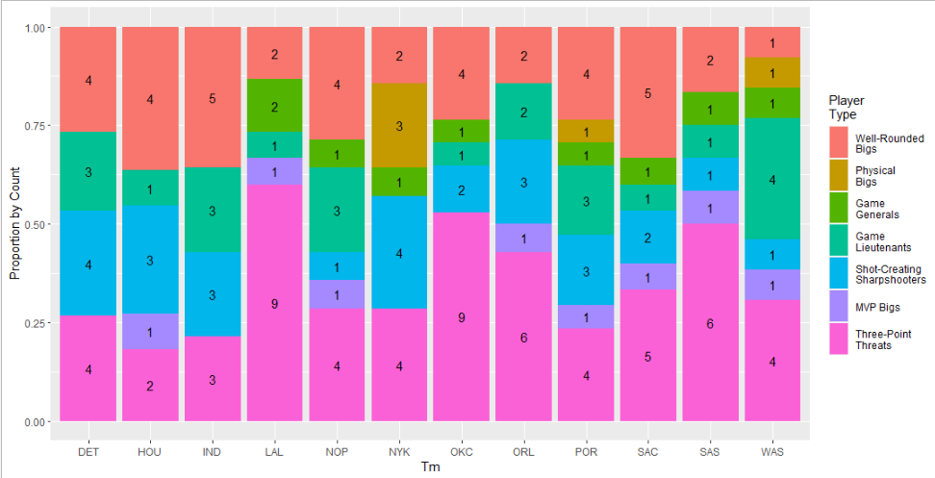
Teams BELOW .500 in 2022
LA Lakers
Have two Game Generals and one MVP Big
Detroit & Indiana
Don’t have a Game General or a MVP Big
All Other Teams
Have at least one Game General or one MVP Big
Notes:
With teams below .500, we found that they’re often lacking MVP Bigs and Game Generals - with the exception being the Lakers who have Lebron, Russell Westbrook, and Anthony Davis. Unfortunately the Lakers were plagued by injuries in 2022.

Slide 27
Application - Arthur

Slide 28
Design Intent
Main Goal
Integrate each major portion of the project into a SINGLE, TANGIBLE PRODUCT for the Sacramento Kings Organization.
1
ANY MEMBER of the management team
Can use the application
2
ANY MEMBER of the management team
Should be able to arrive at similar conclusions as per the recommended mock draft strategy
3
ANY MEMBER of the management team
Should be able to perform their own exploratory data analysis with the help of our tools

Slide 29
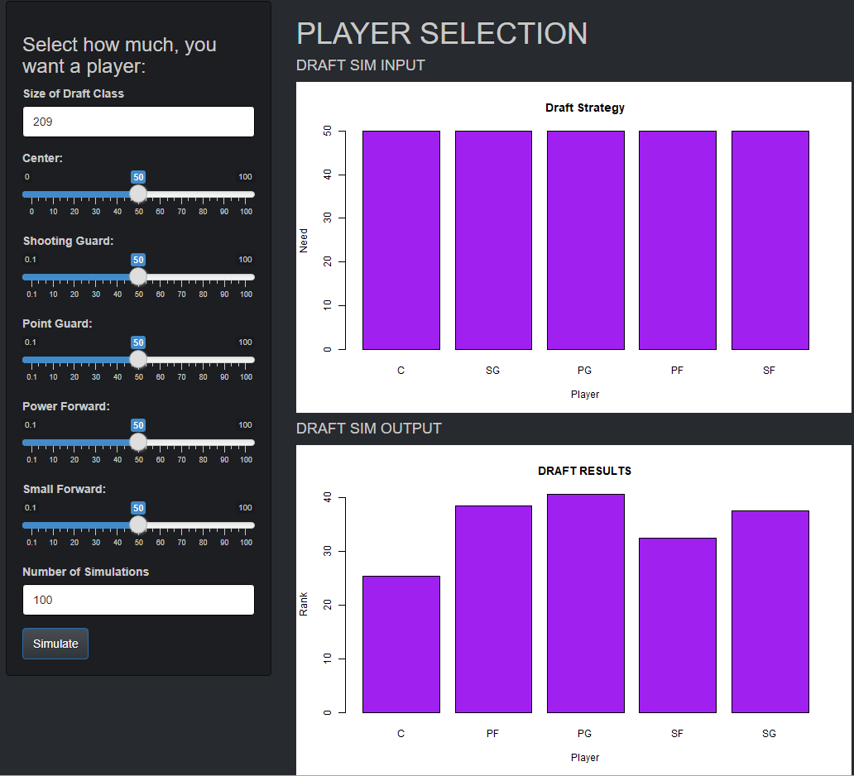
Mock Draft Strategy
3 User Items to Select
Item 1
Item 2
Item 3
Output
Size of draft
Sliders for desire for different players
Number of simulations to run
Average player rank drafted by position

Slide 30
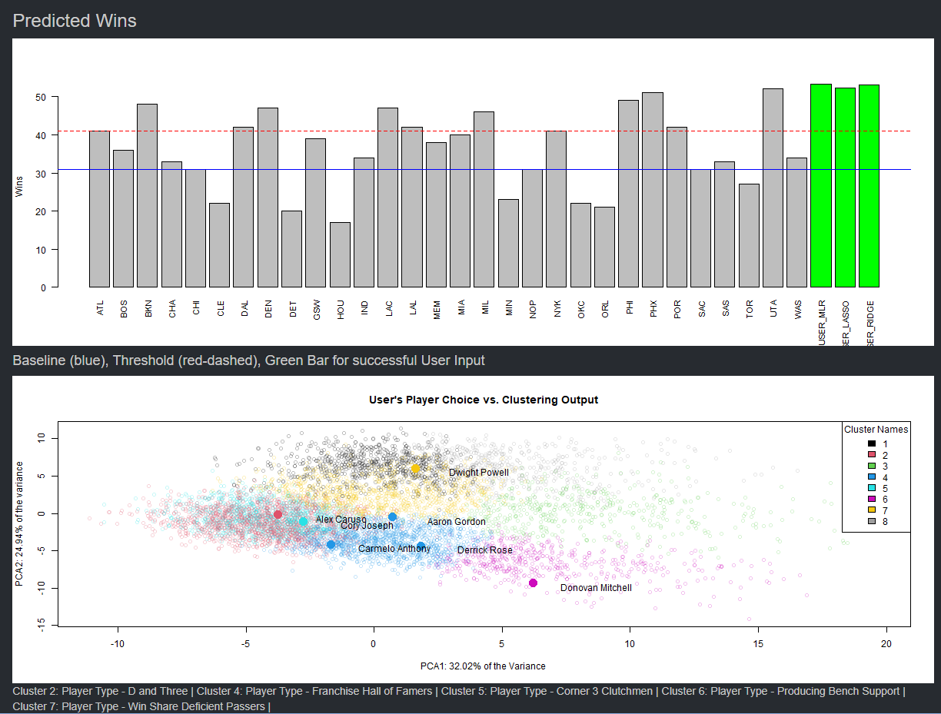
Player Selection
1
2
3
Summary Table
Win Prediction
Team selection
Populates with each player selected
Predicts wins with user selected team. Successful choices will be highlighted green
Team selection populates a cluster plot to show player types

Slide 31
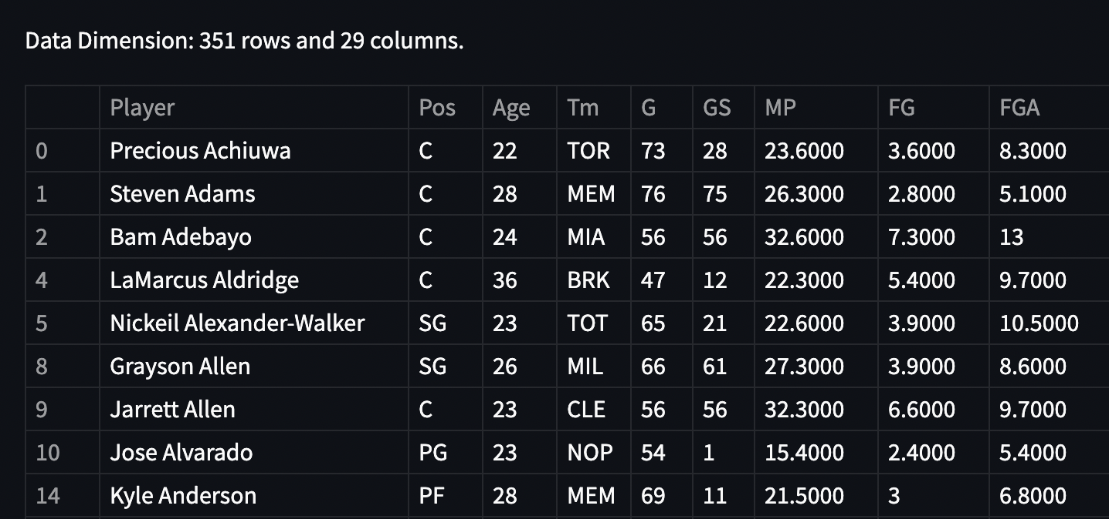
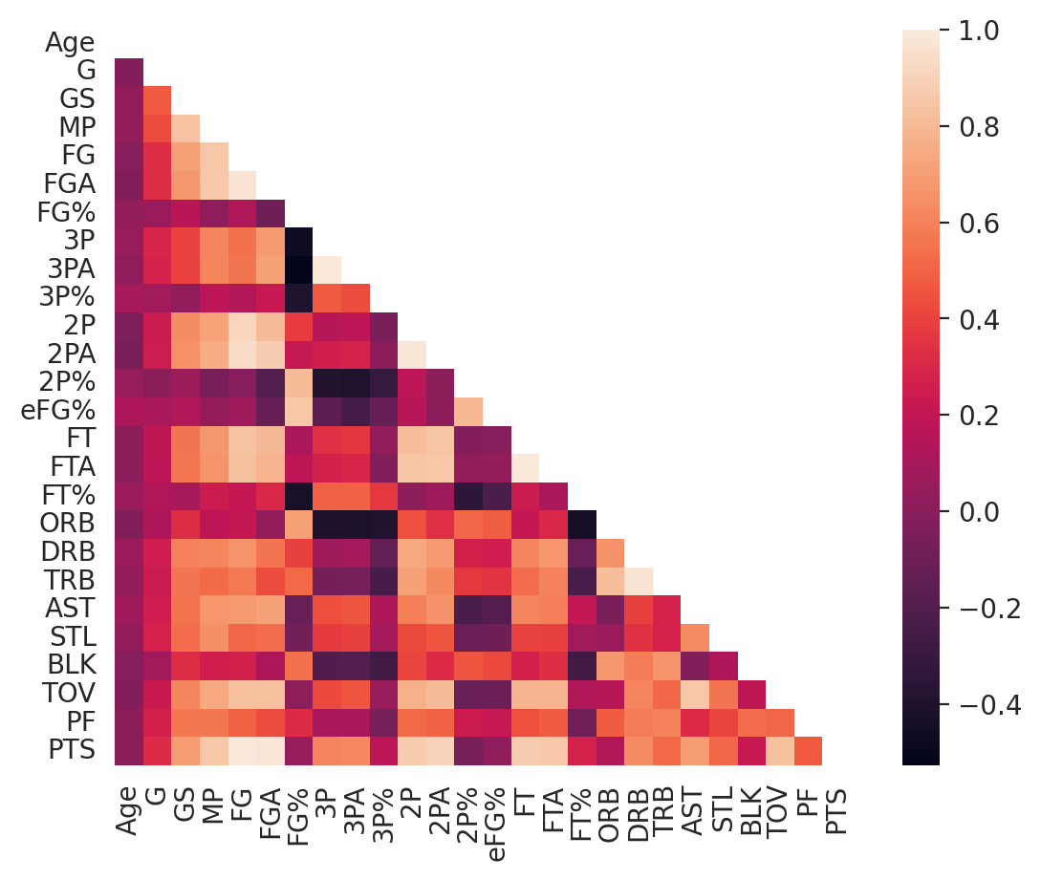
EDA Tool
Perform their own analysis on the same datasets this team used to gain insights for the Sacramento Kings.
EDA tool allows the user to:
Year or season, player statistics, teams to include, and positions to consider
User inputs are broken down by:
Allows user to investigate teams, common player statistics
Player statistics table by group input is first displayed

Slide 32
Recommendations - Anaswar, Danish

Slide 33
Regression - Anaswar
Prioritize PLUS/MINUS (+/-)
Recommendation 1
What is +/- good at?
Notable Flaw of +/-
Notable Flaw of +/-
One of the few metrics which both correlates to wins as well as not correlate to other major metrics
Most notable flaw is that it is affected by how well other players in a team are playing
+/- will increase when teammate starts to shoot well but it was not player’s contributions that caused +/- to increase
In game 7 of the 2022 NBA playoffs, Chris Paul posted a +/- of -39, the worst in his NBA career. Suns ended up losing the series
Factors such as team chemistry, how well a player fits in a team impacts +/- but are not factored in calculating it

Slide 34
Regression - Anaswar
Investigate Real Plus/Minus (RPM)
Recommendation 2
Useful in differentiating between players who have been consistently good throughout their careers, historically bad players who happened to have a few good seasons.
Unlike other descriptive metrics, RPM is a predictive metric that factors in past player performance to measure current player performance
Most notable flaw is that it tends to fall short when evaluating a player whose improvements/regressions end up being higher/lower than expected given age.

Slide 35
Regression - Anaswar
Measures player productivity/performance by considering both positive and negative metrics.
PER is measured on a per minute basis & adjusted for pace.
Most notable flaw is that it is primarily an offensive driven metric and to a degree fails to measure a player's potential defensive impact.
Investigate Player Efficiency Rating (PER)
Recommendation 3
Not the metric of choice for describing a player’s overall performance.
Can be used as a baseline to compare overall performance for players and teams alike.
Notes:
Measures player productivity & performance by considering both positive and negative metrics.
Results in PER returning a value for each player accomplishment.
What separates PER from other metrics is that PER is measured on a per minute basis & adjusted for pace.
Can be used as a baseline to compare overall performance for players and teams alike.
Not the metric of choice for describing a player’s overall performance.
Summarizes player's statistical accomplishments, unify major NBA metrics in a single metric.
Most notable flaw is that it is primarily an offensive driven metric and to a degree fails to measure a player's potential defensive impact.

Slide 36
Cluster Analysis - Danish
Most important player types are Game General and MVP Big - Kings currently roster both
Analysis 1
Analysis 2
Analysis 3
Analysis 4
De'Aaron Fox has developed into the player we hoped he’d become after drafting him in 2017. Continues to act the team’s Game General
Domantas Sabonis was acquired from Indiana towards the end of the 2021-22 season, serves as our MVP Big
Despite playing few games, Sabonis will likely play a larger part in our success in 2022-23
Adding another Game Lieutenant to support our Game General (De'Aaron Fox) would likely add depth to our team in the long run

Slide 37
Cluster Analysis - Danish
Currently don’t have a Physical Big on the team - this trends in the right direction
Currently have five Well-Rounded Bigs, five Three-Point Threats
Physical Bigs
Has decreased from 24% of the players in 2000-2001 to 4.7% of the players in 2021-2022.
Well-Rounded Bigs
Trending upwards. Should evaluate our current Well-Rounded Bigs to see if they can potentially become MVP Bigs.
Shot-creating Sharpshooters
Tend to transition into Game Generals more often than other player types
Analysis 2
Analysis 4
Analysis 1
Analysis 3
Analysis 5
Three-Point Threats
Despite importance of three point shot, recent stats show us that this player type is trending slightly downwards
Shot-creating Sharpshooters
Potentially add another player who is of the Shot-creating Sharpshooters player type, work to develop the current players in that role.

Slide 38
Mock Draft Simulation - Danish
An ECLECTIC PICKING STRATEGY generally led to better-ranked players
Analysis 1
Analysis 2
Analysis 3
If other teams wanted the same position earlier in the draft order, the Kings would be left with a poorer ranked player on average
As DOE shifted to two and three player pick strategies, franchise RECEIVED BETTER RANKED PLAYERS across ALL DESIRED POSITIONS relative to pick-one strategy
Results did not fundamentally change with changes in draft class size, merely a shift in average ranked players drafted due to scarcity of players

Slide 39
Final Recommendations - Michael, Arthur, Anaswar

Slide 40
Draft Picking Strategy - Arthur
Eclectic picking strategy generally led to better-ranked players
Form an ECLECTIC Draft Picking Strategy
Shift to TWO and THREE-player
PICK STRATEGIES
Franchise received better-ranked players across all desired positions than pick-one strategy

Slide 41
Which Stats to Focus On? - Anaswar
Stat 1
Stat 2
Stat 3
Plus-Minus (+/-)
Real Plus/Minus (RPM)
Player Efficiency Rating (PER)
One of the few metrics which correlates with wins but doesn’t correlate with other major metrics
Useful in differentiating between historically good and bad players
Measures the productivity and performance of a given player by considering both positive and negative metrics
PER - statistical accomplishments are summarized, major metrics unified as single metric.

Slide 42
Evaluating and Updating Current Roster - Michael
1
2
3
Assign every player to one of the seven new player types
Currently have five players in both the Well-Rounded Bigs and Three-Point Threats player type
Should potentially add another player to the Game Lieutenant player type to support our Game General
We currently have a Game General (De'Aaron Fox) and an MVP Big (Domantas Sabonis)
Adding another Game General or MVP Big would be ideal
May be unrealistic given their desire, limited number of players that are of this player type
Need to determine whether this amount of players in that position is gratuitous
Can we develop one of these players into a Game General or MVP Big?
Perhaps add another player that is of the Shot-Creating Sharpshooter player type to help the team long-term.

Slide 43
Future Work - Danish

Slide 44
Items of Interests
Take the WIN PREDICTION MODELS and CONNECT them to the business side of the organization
PRODUCTION version of the APPLICATION
Allow users to pick a team to optimize draft/player selection strategy
Create the SUBSCRIPTION MODEL to BENEFIT from this APPLICATION at scale
Item 1
Item 3
Item 5
Item 2
Item 4
Item 6
Take caution that there is no data for every current contract on every player from the past 20 years to convert win model to win per dollar metric
Sacramento Kings could SELL THIS SOFTWARE to other organizations
Shiny application development great for 2-20 concurrent users

